Slide 1
Mini Project
MBS 3523(AI and Programming)
Group Member:
CHAN Tickey Shek Nam 200064348
CHENG HO MAN 200169785
XU HAO LE 200057879

Slide 2
voice system

Slide 3
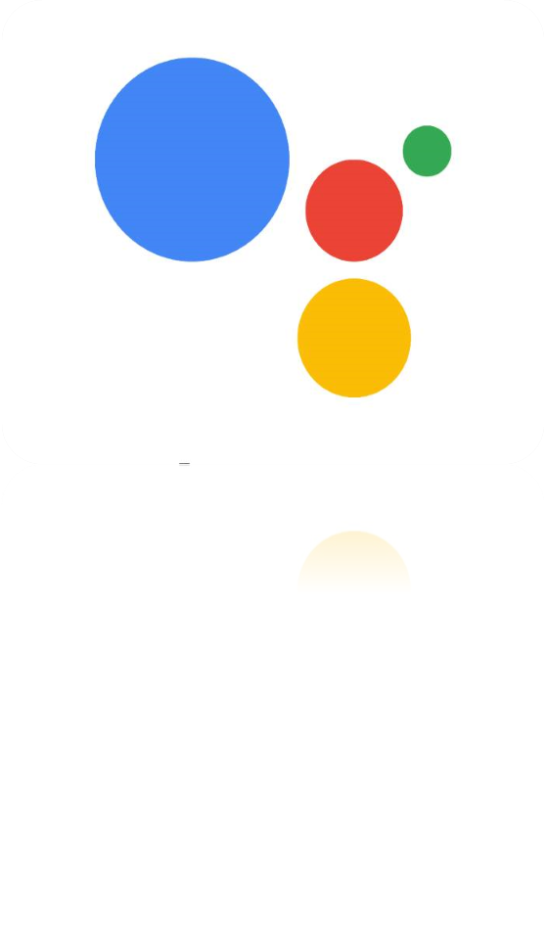
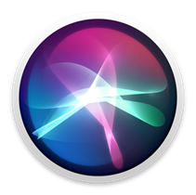

Background
Voice systems are systems that a user interacts with by listening to spoken prompts from an automated system.

Slide 4
What is Speech recognition
Speech recognition is an interdisciplinary subfield of computer science and computational linguistics.
It has developed some methods and technologies that can recognize and translate spoken language into text through computers.
It is also called Automatic Speech Recognition (ASR), Computer Speech Recognition or Speech to Text (STT).

Slide 5
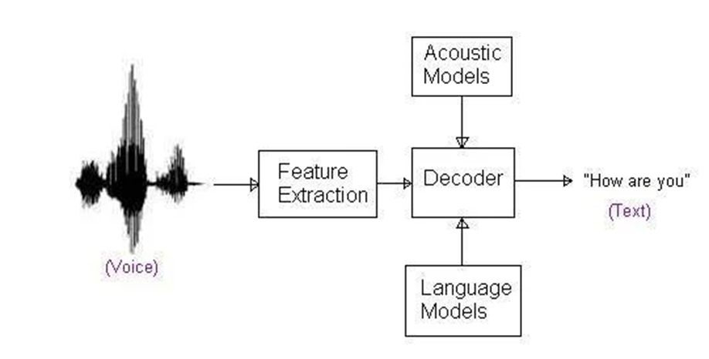
Principle

Slide 6

Background
The first modern digital virtual assistant installed on a smartphone is Siri (Steve Jobs)
2011
The smart personal assistant developed by Google is integrated in the Allo application, Google Home device...
2012
“小度” AI speaker 1S is released, the function can be upgraded to infrared control traditional home appliances
2019

Slide 7
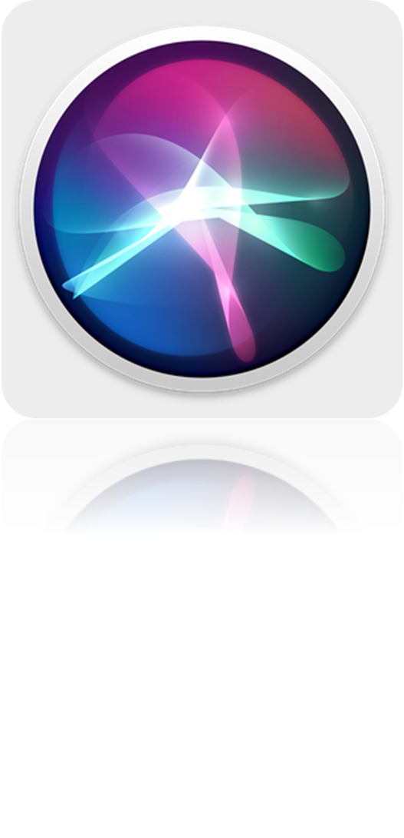
Significance
In this hectic society, people will need convenience and speed, and they need an assistant to help manage your daily life all the time, so we need a voice assistant

Slide 8
Python Library
gtts
pygame
datetime
speech_recognition
temfile

Slide 9
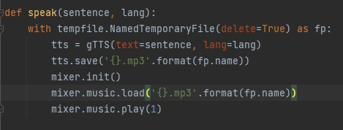
Features

Slide 10
Programme

Slide 11
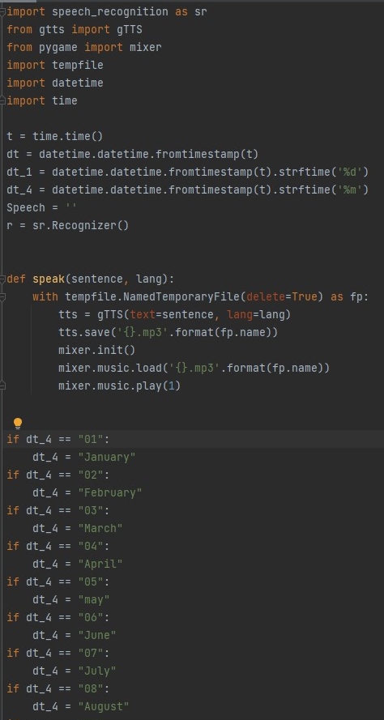
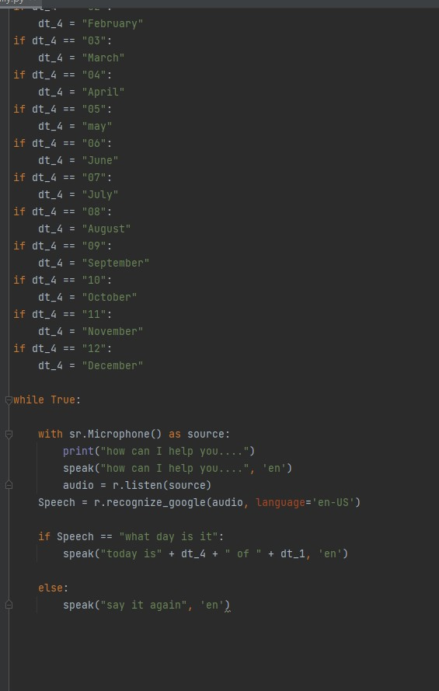

Slide 12

Demonstration
https://youtu.be/VIyfi1z1-n4

Slide 13
References
https://www.youtube.com/watch?v=dGY9en_z5bQ
https://www.lfd.uci.edu/~gohlke/pythonlibs/
https://www.programiz.com/python-programming/datetime/current-datetime
https://www.programiz.com/python-programming/datetime/current-time

Slide 14
THE END

